Slide 1

12 Questions
Le Cai

Slide 2
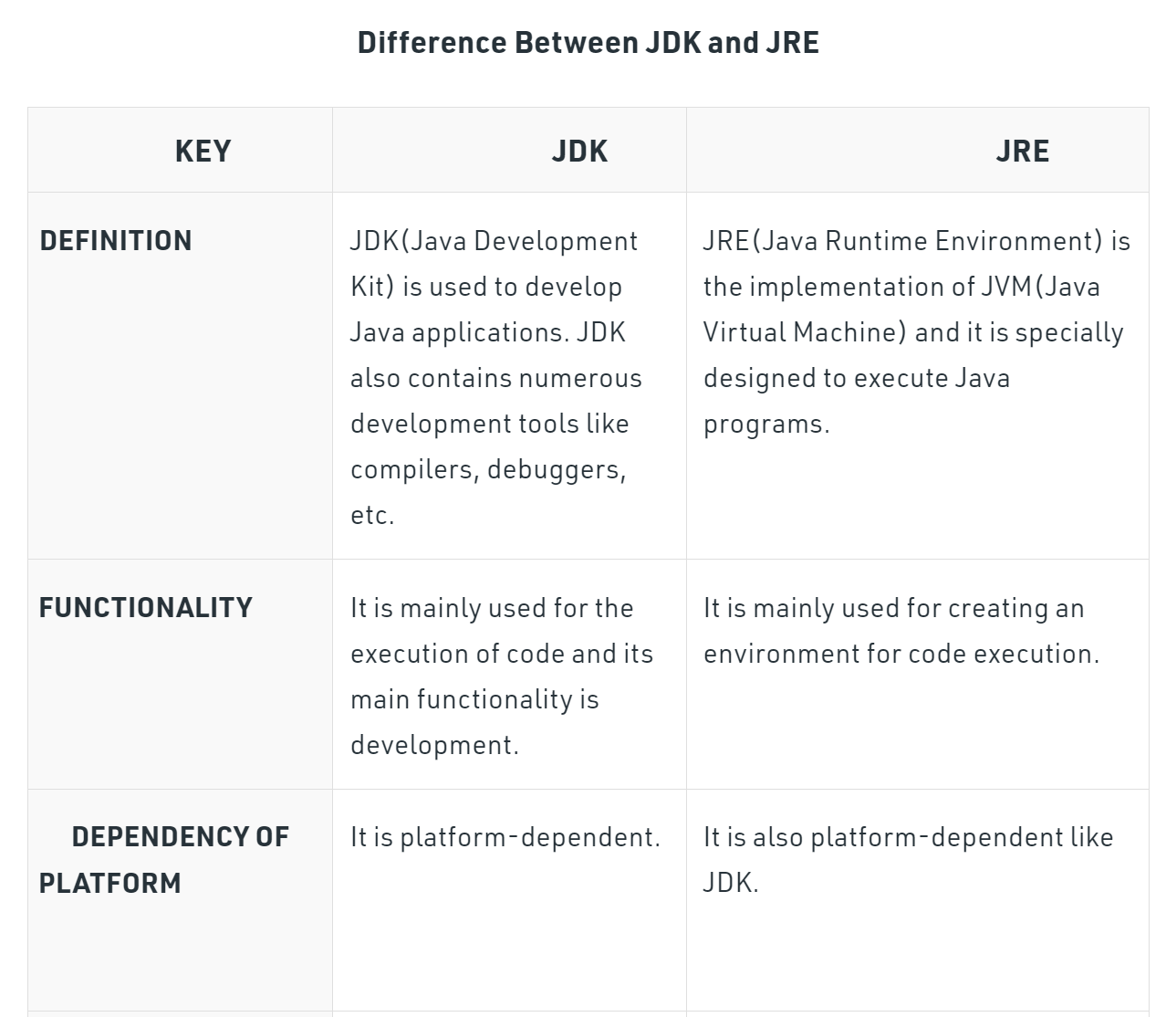
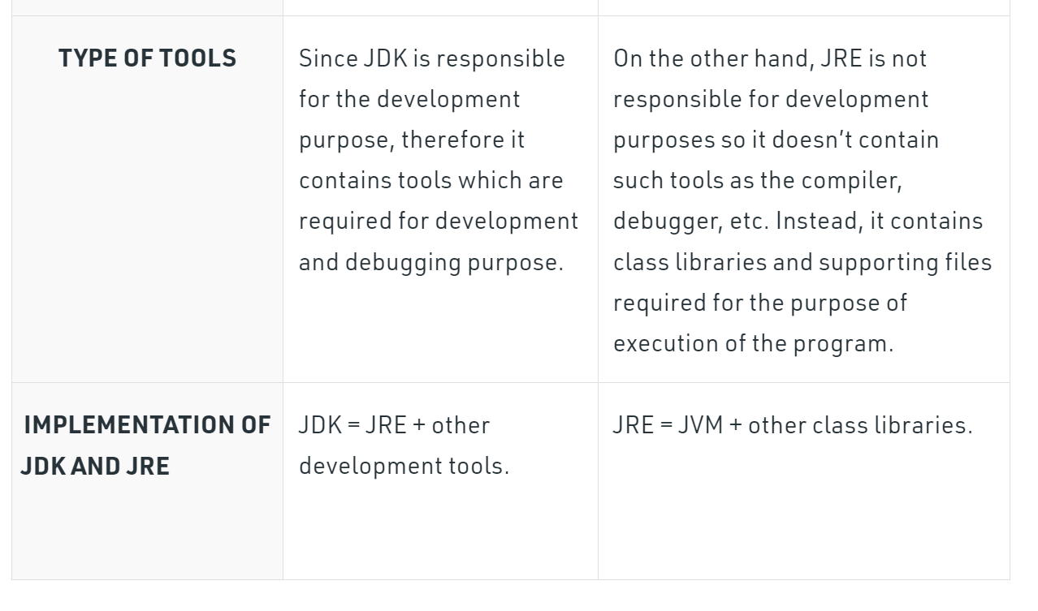
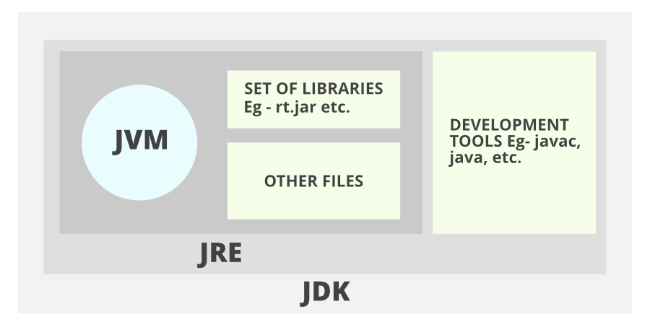
1. What is the difference between JDK and JRE?

Slide 3
2. What is Java Virtual Machine (JVM)?
Java Virtual Machine (JVM) is a engine that provides runtime environment to drive the Java Code or applications. It converts Java bytecode into machines language. JVM is a part of Java Runtime Environment (JRE). In other programming languages, the compiler produces machine code for a particular system. However, Java compiler produces code for a Virtual Machine known as Java Virtual Machine.

Slide 4
3. What are the different types of memory areas allocated by JVM?
Different functions can take different forms of memory structure. In JVM, the memory can be divided into 5 different parts:
Class(Method) Area
Heap
Stack
Program Counter Register
Native Method Stack
Class Loader:
As a subsystem of JVM, the Class Loader is used to load class files and is principally responsible for the below activities.
Loading
Linking
Initialization
Class(Method) Area:
The class-level data of every class is stored by the Class(Method) Area. This class level data can be a runtime constant pool, field and method data, or the code for methods.

Slide 5
4. What is JIT compiler?
In computing, just-in-time (JIT) compilation (also dynamic translation or run-time compilations) is a way of executing computer code that involves compilation during execution of a program (at run time) rather than before execution. This may consist of source code translation but is more commonly bytecode translation to machine code, which is then executed directly.

Slide 6
5. How Java platform is different from other platforms?
The three major differences between Java platform and most other platforms are:
• It is a software-based platform while others can be hardware based or hardware software platform.
•Java supports WORA (Write once run anywhere),which means it is platform independent, but many of other platforms does not provide such feature.
• The Java API enable users to write java program, which are converted to byte code by interpreter and then into machine language by complier, whereas other platform provide either complier or interpreter.

Slide 7
6. Why people say that Java is 'write once and run anywhere' language?
Java applications are called WORA (Write Once Run Anywhere). This means a programmer can develop Java code on one system and can expect it to run on any other Java-enabled system without any adjustment.

Slide 8
7. How does ClassLoader work in Java?
The Java ClassLoader is a part of the Java Runtime Environment that dynamically loads Java classes into the Java Virtual Machine. The Java run time system does not need to know about files and file systems because of classloaders. Java classes aren't loaded into memory all at once, but when required by an application.

Slide 9
8. Do you think 'main’ used for main method is a keyword in Java?
Main is not a keyword in Java. When you try to execute a java code using "java" command, the runtime will load the public class that you are trying to execute and then call the main method defined in the class. The runtime knows that "main" is the method to look for as it is designed that way.

Slide 10
9. Can we write main method as public void static instead of public static void?
Yes, we can change the order of public static void main() to static public void main() in Java, the compiler doesn't throw any compile-time or runtime error. In Java, we can declare access modifiers in any order, the method name comes last, the return type comes second to last and then after it's our choice.

Slide 11
10. In Java, if we do not specify any value for local variables, then what will be the default value of the local variables?
The local variables do not have any default values in Java. This means that they can be declared and assigned a value before the variables are used for the first time, otherwise, the compiler throws an error.

Slide 12
11. Let say, we run a java class without passing any arguments. What will be the value of String array of arguments in Main method?
By default, the value of String array of arguments is empty in Java. It is not null.

Slide 13
12. What is the difference between byte and char data types in Java?
Both byte and char are numeric data types in Java. They are used to represent numbers in a specific range. Major difference between them is that a byte can store raw binary data where as a char stores characters or text data. Usage of char is E.g. char ch = 'x'; Byte values range from -128 to 127. A byte is made of 8 bits. But a char is made of 16 bits. So it is equivalent to 2 bytes.

